Slide 1
Enabling Bioconductor R packages for cagrid services
Session Length: approx 30 minutes
Target Audience: application developers
Trainer: self-paced
Developer contact:
Martin Morgan (mtmorgan@fhcrc.org)
Adopter contacts:
Pan Du (dupan@northwestern.edu),
Simon Lin (s-lin2@northwestern.edu)
Creation Date: May 2007

Slide 2
Session Details
Target Audience:
  Application developers that need to enable Bioconductor R packages to caGrid services or other Java applications
Prerequisites:
  Java programming knowledge
  Basic R programming knowledge
  Web Services practical experience
  Basic UML, caGrid knowledge
Note: Some slides have notes attached. To see these notes, please select the “Normal” option under the View menu on your toolbar.

Slide 3
Session Details:
Session Objectives
By the end of this session, you should be able to
  Describe what Bioconductor / caBIG project for
  Enable the example Bioconductor package to caGrid services

Slide 4
Session Details:
Lesson Plan
Lesson 1: Introduction to Bioconductor / caBIG
Lesson 2: A Use Case: Enabling lumi Package for Grid Services

Slide 5
Lesson 1: Introduction to Bioconductor / caBIG
In this Lesson, we will introduce:
  Introduction to Bioconductor
  Enabling Bioconductor packages to caBIG (or web services)

Slide 6
Bioconductor
Application background
Open source statistical software
  >200 contributed packages
  R programming language
High-throughput gene expression analysis
  Expression array pre-processing, linear models, clustering and machine learning, expression pathways, …
  Sophisticated visualize tools
  Flexible ad hoc analyses

Slide 7
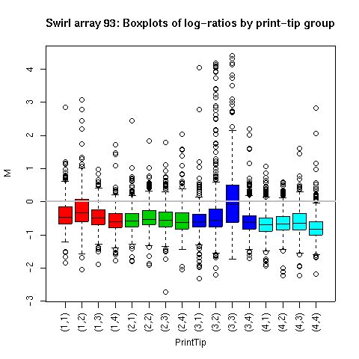
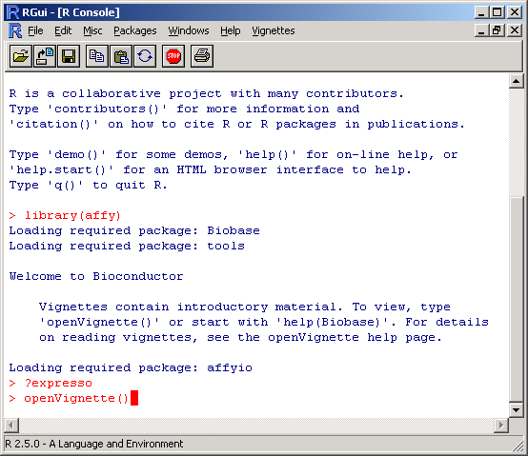
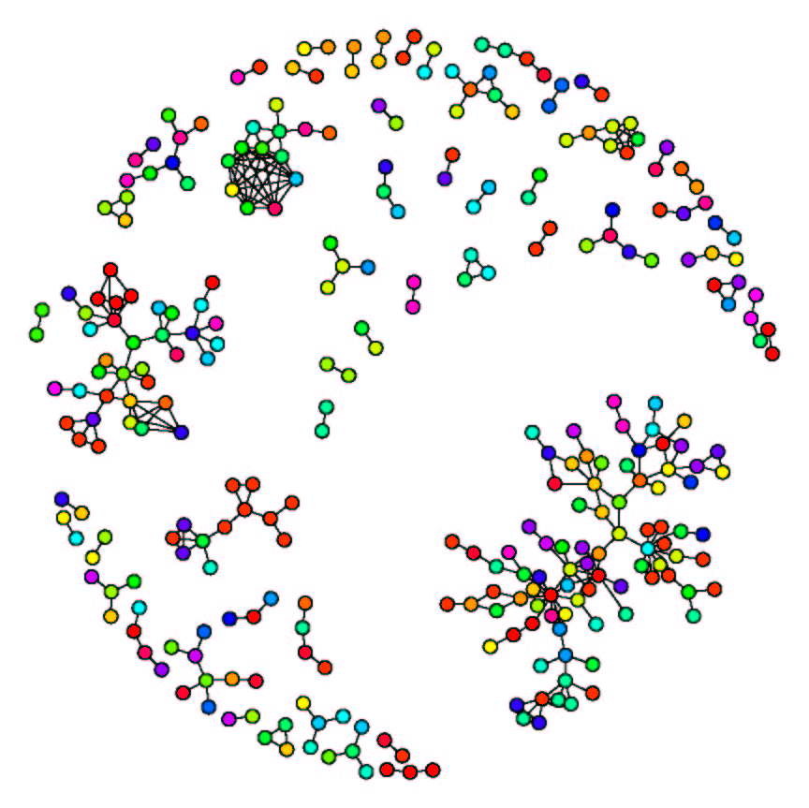
Bioconductor
Application screenshot

Slide 8
caGrid-enabled packages
Analytic services (caBig gold compatible)
  Mass spec. peak identification – caPROcess
  DNA copy number variation – caDNAcopy
  Microarray preprocessing – caAffy
Benefits to users
  Powerful analysis methods
  Specialized computing resources
  Easy maintenance

Slide 9
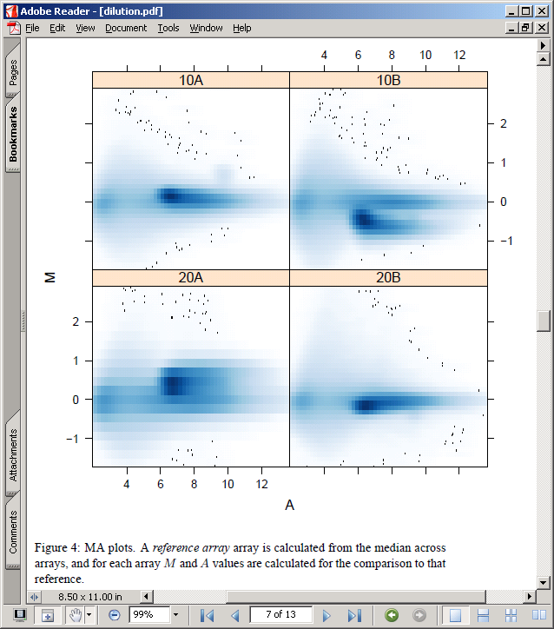
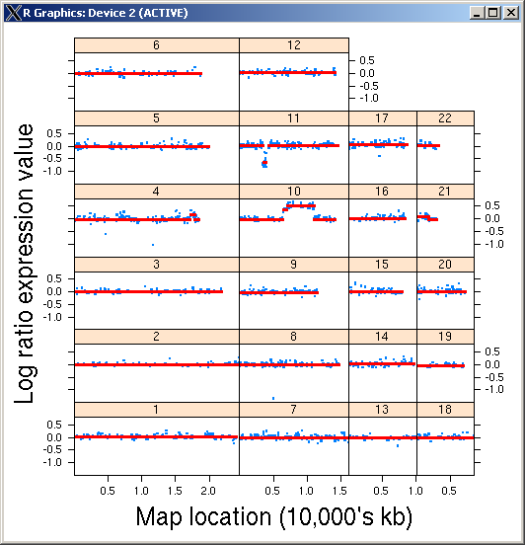
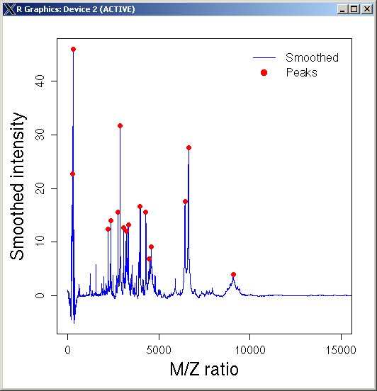
Examples of package functionalities

Slide 10
Deploying enabled packages
Benefits to working groups
  Standardized analysis pipelines
  Effective resource use
  Centralized system administration
Technical aspects
  System architecture
  Configuration and deployment
  (Deploying as web services)

Slide 11
Scalable, flexible system architecture
Tomcat
caGrid
Bioconductor
service
Bioconductor
worker 1
activeMQ
Bioconductor
worker 2
Etc.

Slide 12
Deploying caGrid-enabled packages
Hardware requirements
  Bioconductor workers: 32- or 64-bit linux-based
Service software
  Tomcat, caGrid
  activeMQ, Bioconductor workers (managed via ant tasks)
caGrid-enabled packages are introduce projects
  Bioconductor and caGrid properties files
    E.g., activeMQ server host and port
  Deploy with introduce ant targets

Slide 13
Creating caGrid-enabled packages
Benefits to researchers and analysts
  Tailored, standardized analysis pipelines
  Make new methods easily available
Bioconductor packages
Steps to caGrid-enable existing packages
  Identify appropriate functionalities, standardize input and output data classes
  Strong typing – TypeInfo
  R to Java mapping – RWebServices, SJava
  caGrid-specific steps – introduce
Goal: easily create caGrid services from Bioconductor packages
  As little human intervention as possible

Slide 14
Lesson 2: A Use Case: Enabling lumi Package for Grid Services
In this Lesson, we will introduce:
  Introduction to lumi package
  Detailed steps of implementation

Slide 15
Bioconductor lumi package
Provide BeadArray specific methods for Illumina microarrays
  A new variance-stabilizing transformation (VST) algorithm
  A new robust spline normalization (RSN) algorithm
  Provide options of other popular preprocessing methods
Include data input, quality control, variance stabilization, normalization and gene annotation
Compatible with other Bioconductor packages

Slide 16
Overall strategy
Identify appropriate functionality
  Small wrappers for existing functions
Standardize input and output data classes
  R objects
  Type specification
Map between R and Java
Enable as caGrid service
Expose caLumiExpresso function:
caLumiExpresso <- function(
measuredBioAssays,
lumiExpressoParameter) {
…
}

Slide 17
Adding TypeInfo to R functions
Challenge
  R is a weakly typed language, with unspecified return types
Solution
  Annotate methods to specify allowable argument and return values
  Use R’s object system to model complex data types
typeInfo(caLumiExpresso) <-
SimultaneousTypeSpecification(
TypedSignature(measuredBioAssays = "MeasuredBioAssayMatrix", lumiExpressoParameter = "LumiExpressoParameter"),
TypedSignature(measuredBioAssays = "character", lumiExpressoParameter = "LumiExpressoParameter"),returnType = "NumericMatrix")

Slide 18
R to Java mapping – RWebServices, SJava
Data and methods
  Argument and return value data beans
  activeMQ server, Bioconductor service and workers
Automatic test framework
Automatic package reuse
  Sample data conversion
  Documentation
Command:
  ant -Dpkg=caLumi map-package
Java source and test code structure:
src/
…/<DataBean>
…/<service>
…/<worker>
test/
…/<DataTest>
…/<ServiceTest>

Slide 19
Modify the testing code and run the test
Modify the automatically produced a Java test code at:
  test/src/org/bioconductor/rserviceJms/services/caLumiTest.java
Running tests in three terminal windows
  (1) a running activemq
      cd $JMS_HOME
      bin/activemq
  (2) a ‘worker’ to perform calculations
      cd ~/temp/caLumi
      ant precompile start-worker
  (3) the Java program to run the tests.
      cd ~/temp/caLumi
      ant local-test
  Note: “~/temp/caLumi” is where the testing caLumi package located.

Slide 20
caGrid enabling
caGrid service creation
  Data type description (xsd)
  Semantic annotation – caDSR
  caGrid introduce project creation
‘Wrap’ Bioconductor services as caGrid services
  Argument and return value conversion
  Initialize and invoke service
ant task incorporates Bioconductor jars into introduce

Slide 21
Manuals and References
User’s Guide: http://cabigcvs.nci.nih.gov/viewcvs/viewcvs.cgi/bioconductor/Adopter_Northwestern/Task%202.10.2_Final%20End%20User%20Guide/
Installation Guide: http://cabigcvs.nci.nih.gov/viewcvs/viewcvs.cgi/bioconductor/Developer_FHCC/Task%202.15.2_Installation%20Guide/
Technical Manual: http://cabigcvs.nci.nih.gov/viewcvs/viewcvs.cgi/bioconductor/Developer_FHCC/Task%202.15.1_Technical%20Manual/
Software Requirements and Specification: http://cabigcvs.nci.nih.gov/viewcvs/viewcvs.cgi/bioconductor/Developer_FHCC/Task%202.4.2_Final%20Req%20and%20Spec%20Document/
Bioconductor: www.bioconductor.org

Slide 22
Questions?
We would like to hear from you: please send us your questions and/or suggestions.
You can also refer to the user’s guide for more details.

